Slide 1
Ultralite Coding
Domain Model
By Spencer Lofing, Nicholas Walter, Max Maier, Tyler Hogenson, Ben Finnerty

Slide 2
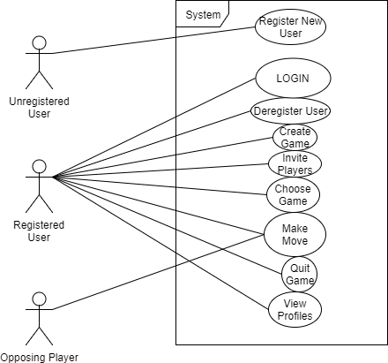
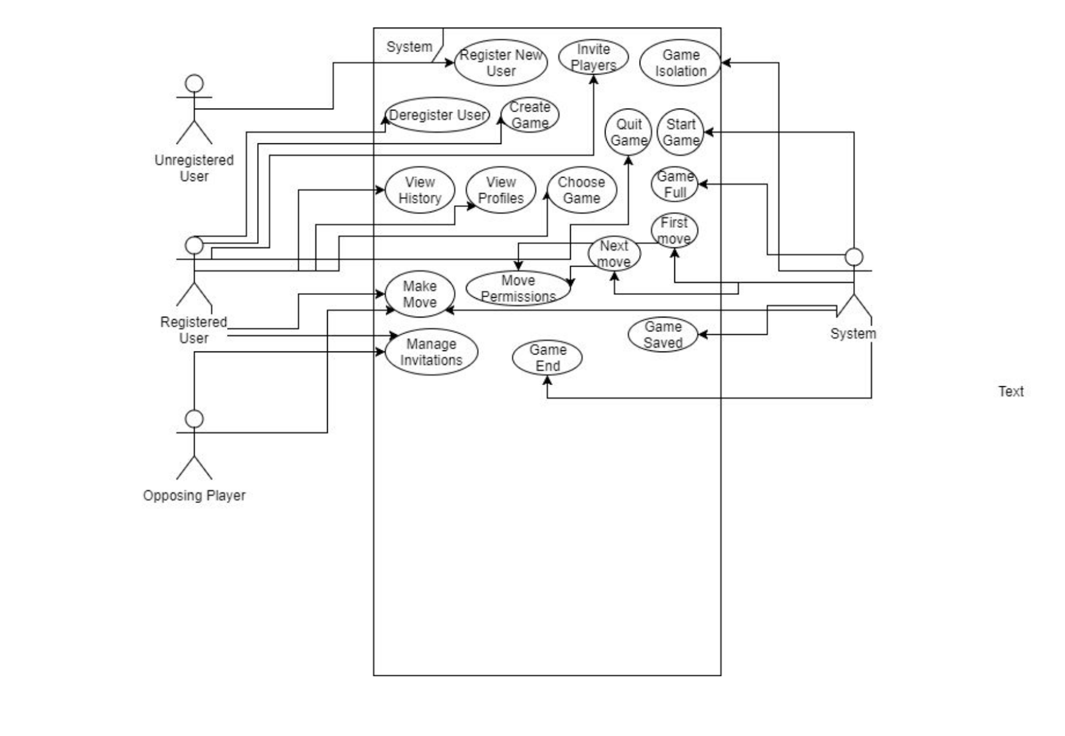
Use Case Diagram

Slide 3
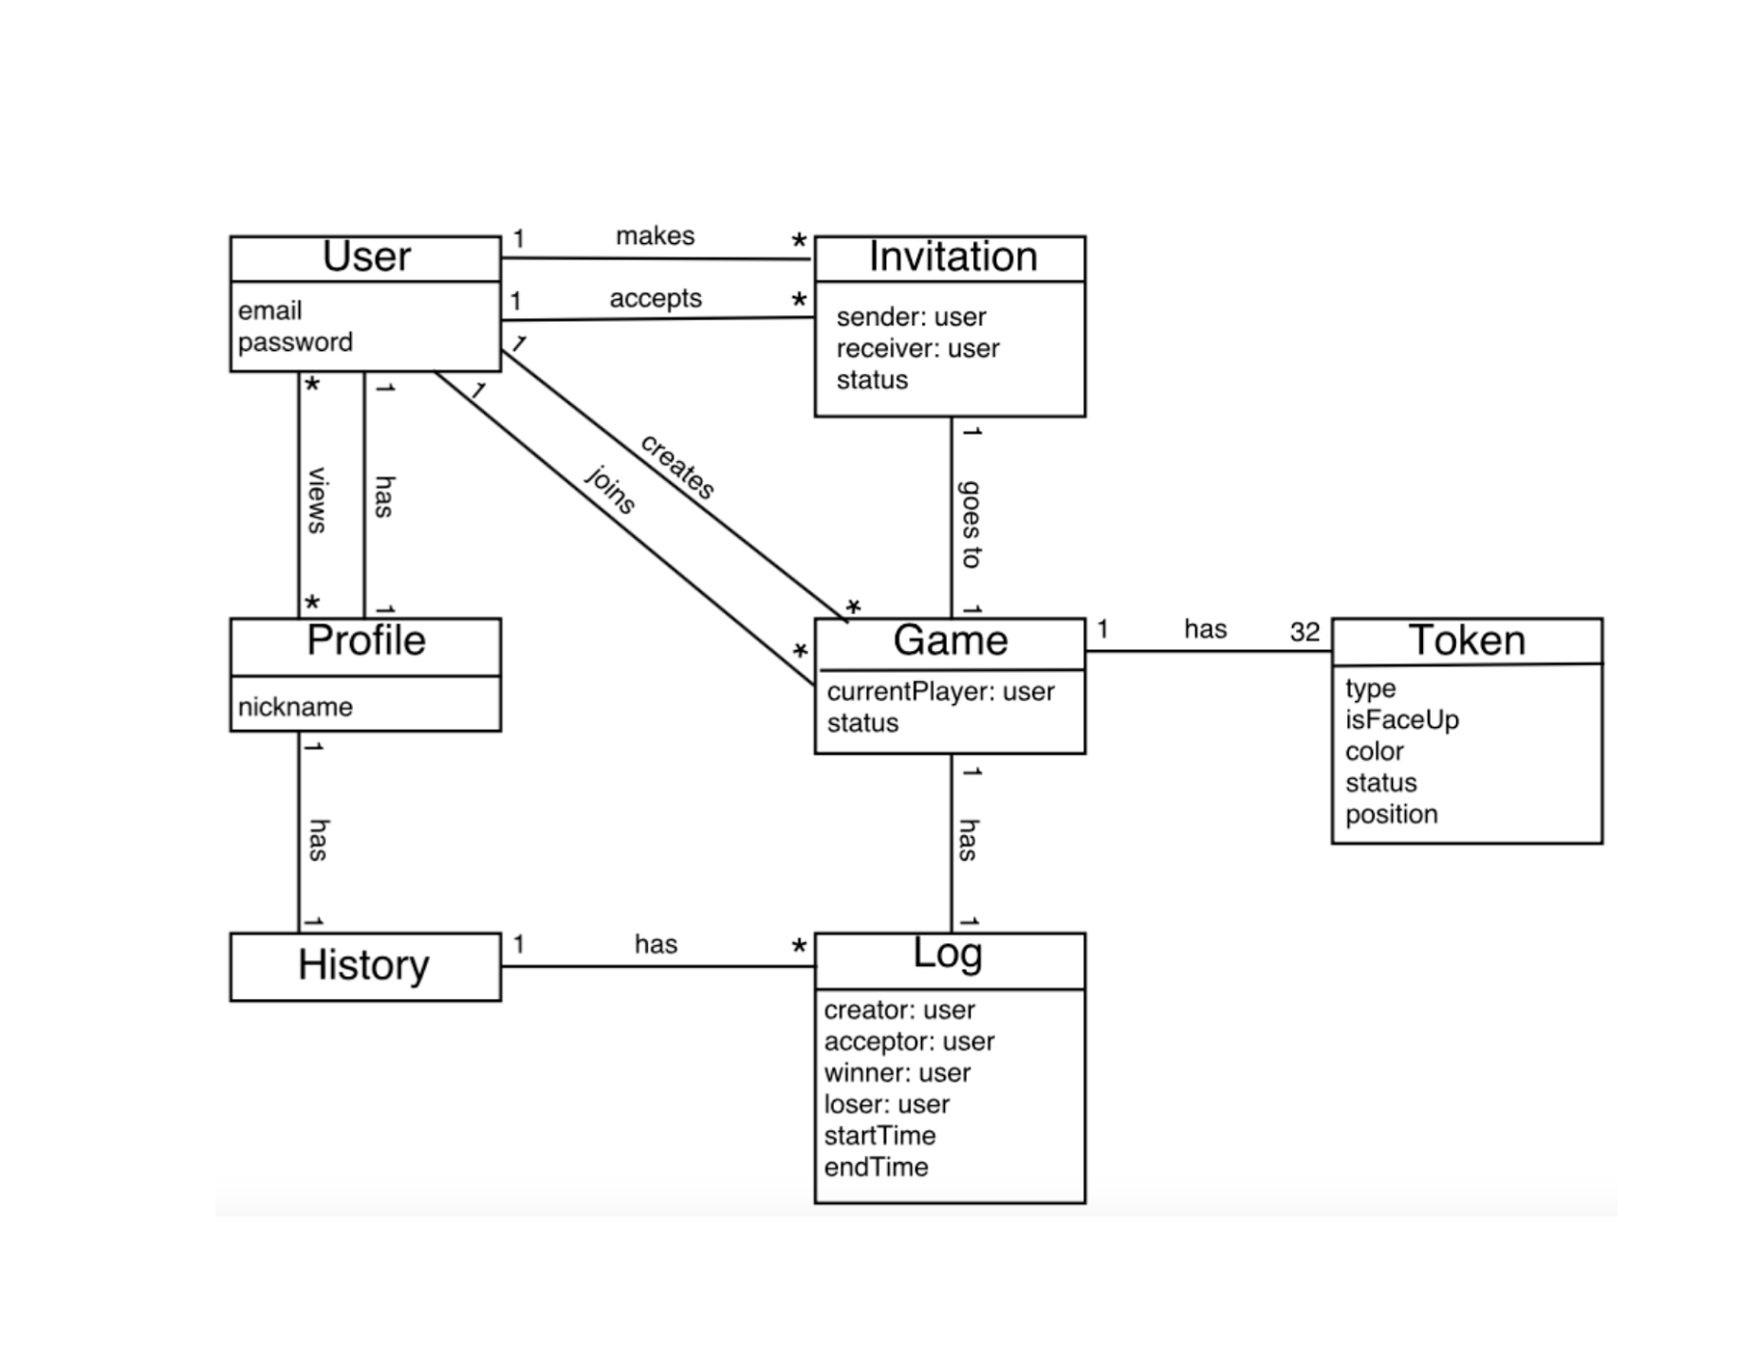
Domain Model

Slide 4
Domain Model Glossary
User
Email - Inputted by the user as they register, this is a unique email used to register the user.
Password - Inputted by the user as they register, this is a personal string they use to login in order to ensure account security and exclusivity.
Invitation
Sender : User - The user that sent the invitation.
Receiver : User - The user to whom the invitation is sent.
Status - Whether the invitation was accepted or rejected.
Profile
Nickname - Inputted by the user as they register, this is a unique shorthand way of recognizing some given user.

Slide 5
Domain Model Glossary Cont.
History
There are no attributes for history, as a history is simply a collection of logs.
Log
Creator : User - The user who created the game. This is also the user who makes the first move.
Acceptor : User - The user who accepted the game invitation for that game.
Winner : User - After the game has ended, this is the user who won the game.
Loser : User - After the game has ended, this is the user who lost the game.
Start Time - The time that the game was created (i.e.; the time the invitation was accepted).
End Time - The time that the game ended.

Slide 6
Domain Model Glossary Cont.
Game
Current Player : User - This is a reference to the player in some active game who is to make the next move.
Status - Whether the game is currently active or inactive (once it becomes inactive, end time/winner/loser are recorded and the log becomes final).
Token
Type - This describes the type of piece of the token, which can be any one of the following - General, Advisor, Elephant, Chariot, Horse, Cannon, or Soldier.
isFaceUp - This is a True or False value used to determine whether or not the piece is face up.
Color - Any given token can have 1 of 2 colors - black or red.
Status - This determines whether or not some given token has been removed from play - meaning that tokens can be active or inactive.
Position - This is the position of the piece on the game board, given as an index. (ex [0, 0])

